Slide 1
Figures for Transport Policy Paper
Seattle non-disrupted SD model

Slide 2
Permanent Duration
Changing Commercial ASU FtCR

Slide 3
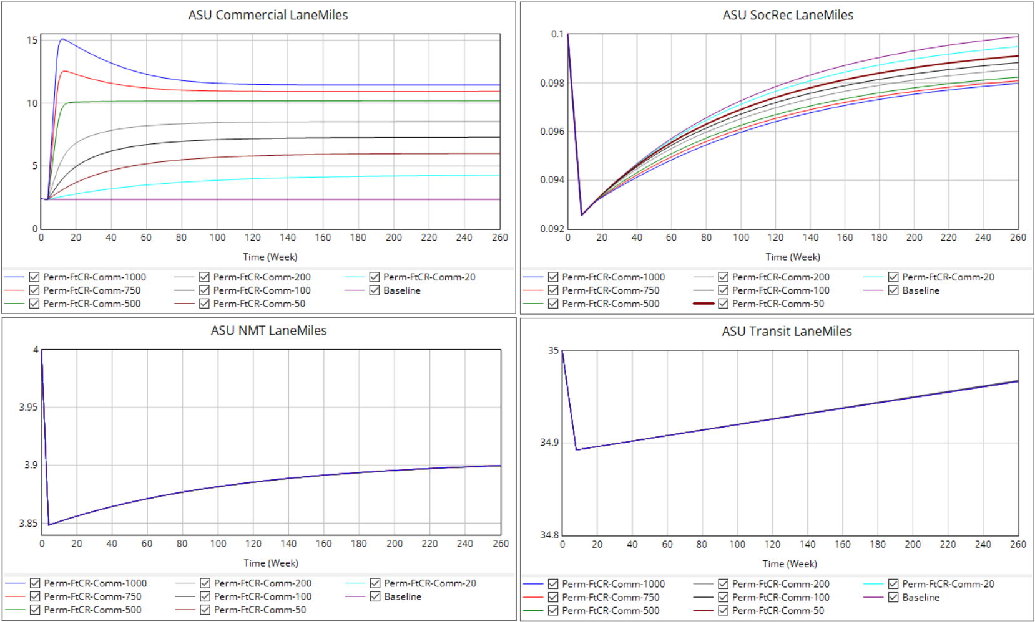
Commercial ASU FtCR effect on… ASU Lane-Miles

Slide 4
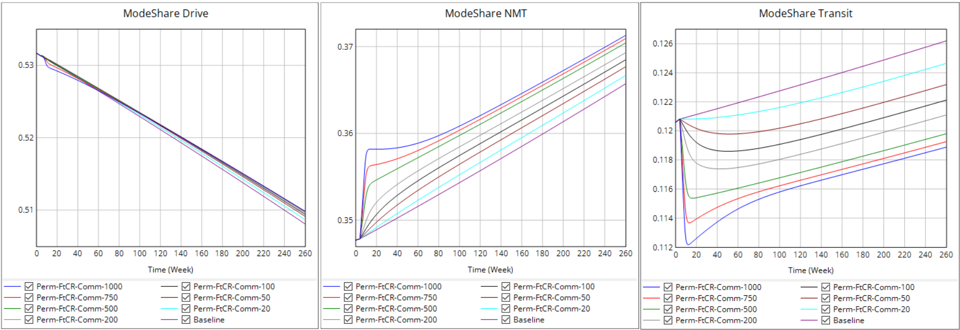
Commercial ASU FtCR effect on… Mode Share

Slide 5
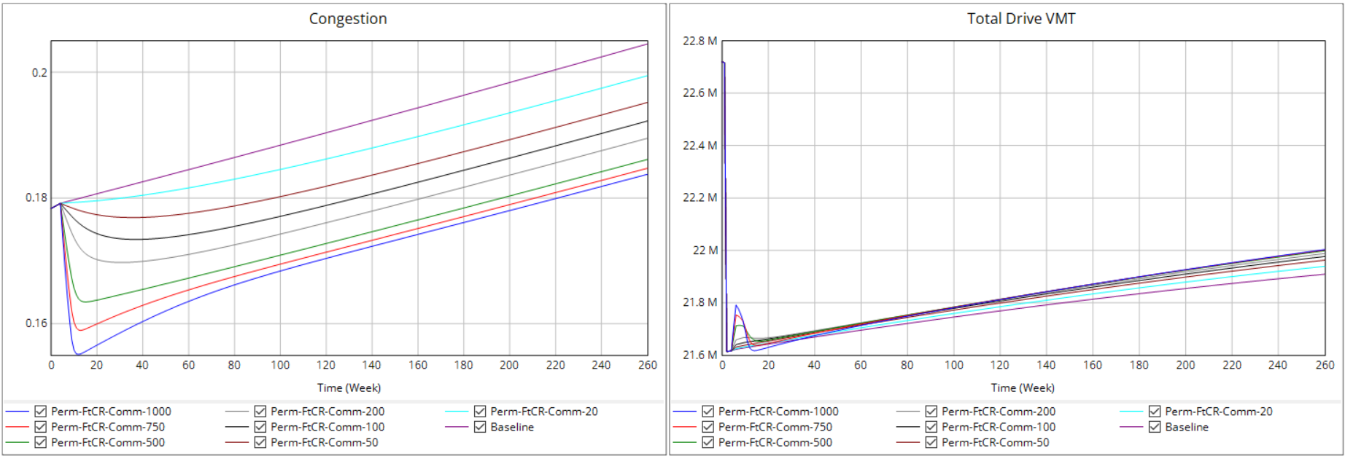
Commercial ASU FtCR effect on… Congestion and VMT

Slide 6
Permanent Duration
Changing SocRec ASU FtCR

Slide 7
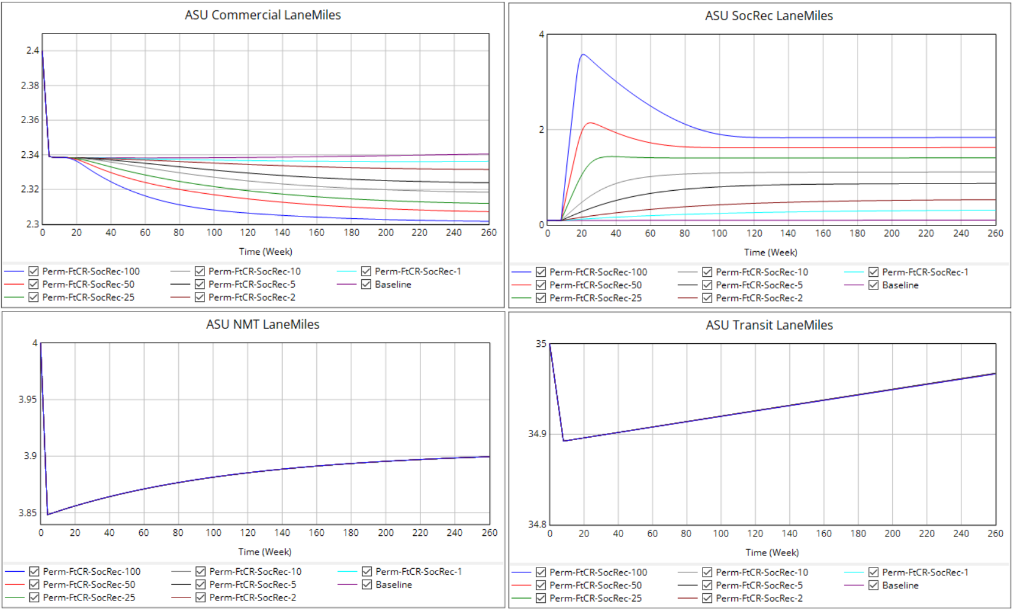
SocRec ASU FtCR effect on… ASU Lane-Miles

Slide 8
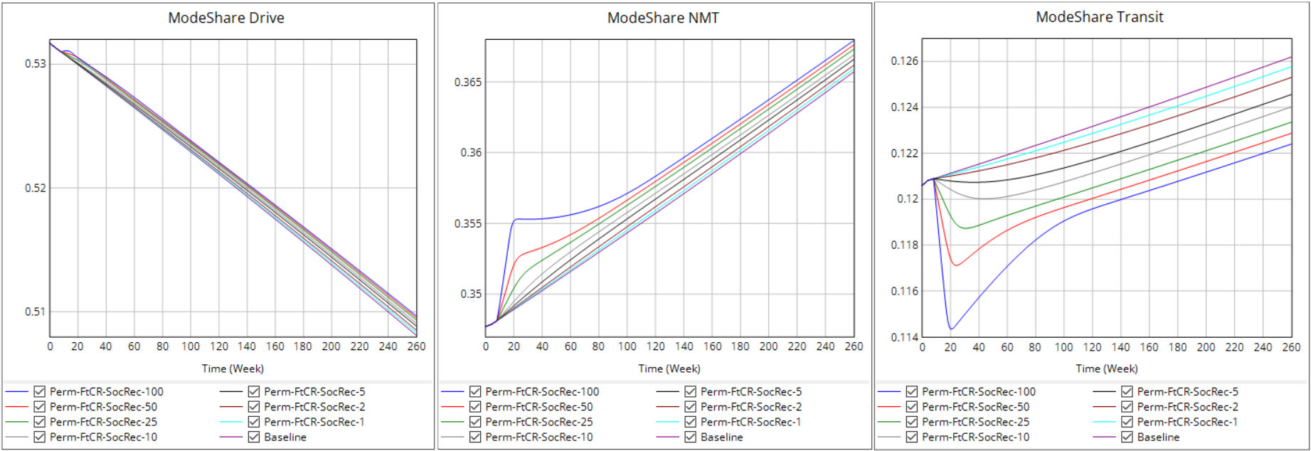
SocRec ASU FtCR effect on… Mode Share

Slide 9
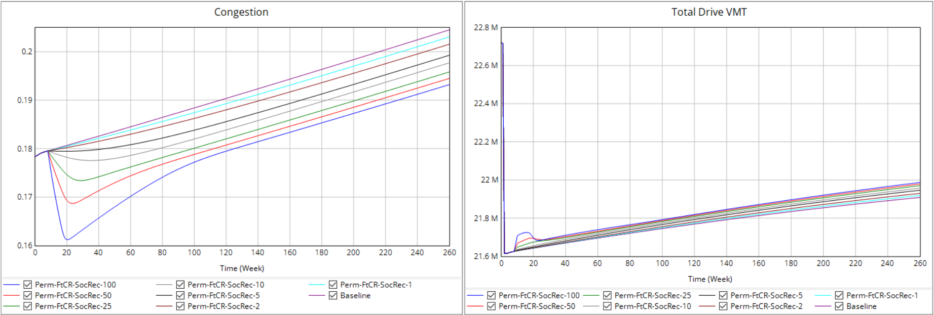
SocRec ASU FtCR effect on… Congestion and VMT

Slide 10
Permanent Duration
Changing NMT ASU FtCR

Slide 11
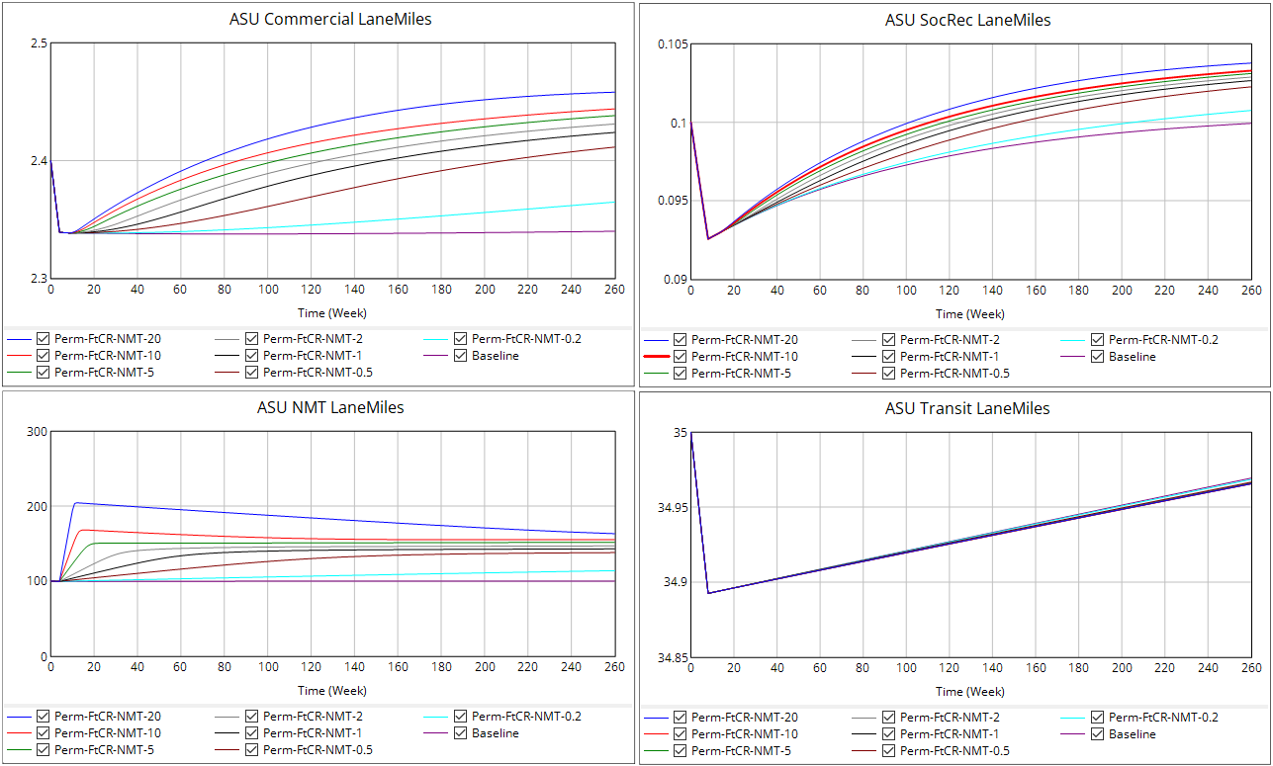
NMT ASU FtCR effect on… ASU Lane-Miles

Slide 12
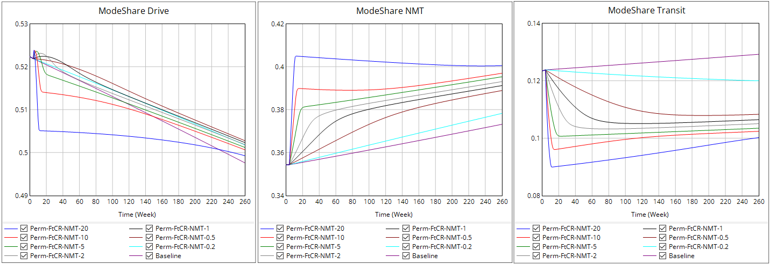
NMT ASU FtCR effect on… Mode Share

Slide 13
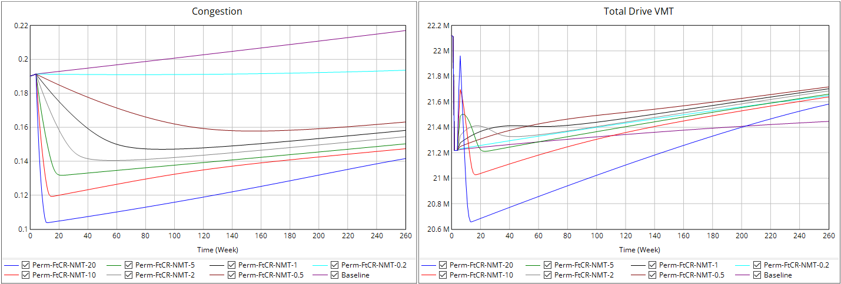
NMT ASU FtCR effect on… Congestion and VMT

Slide 14
Permanent Duration
Changing Transit ASU FtCR

Slide 15
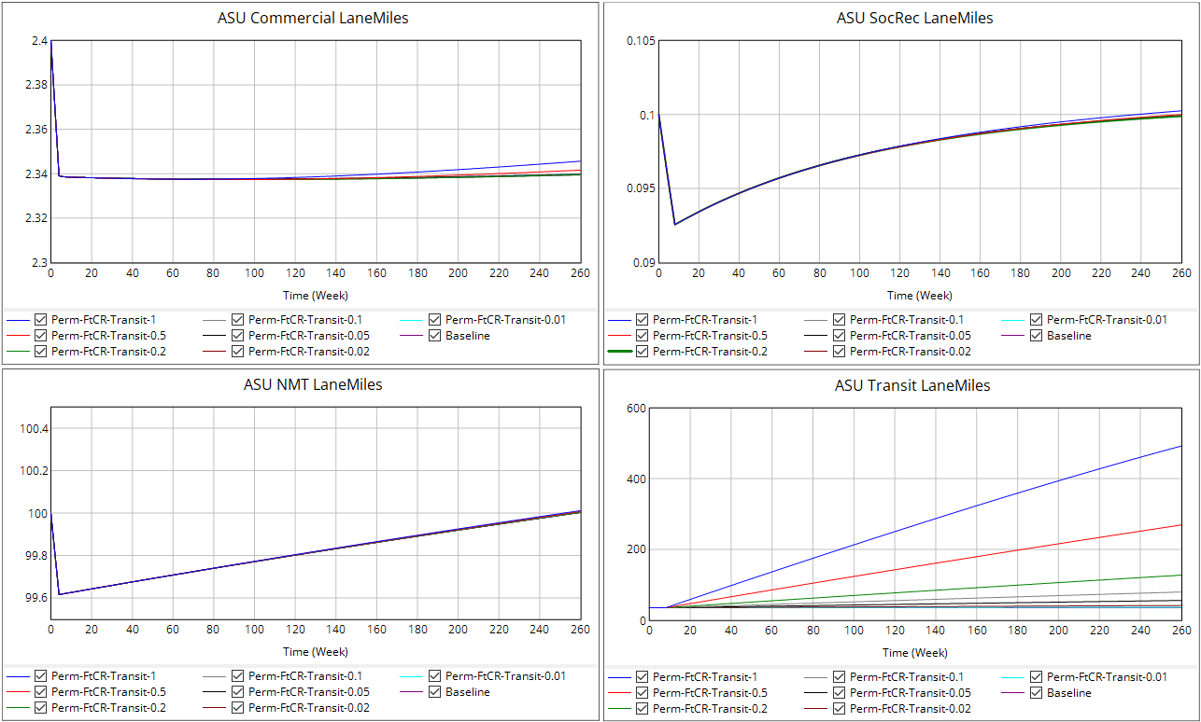
Transit ASU FtCR effect on… ASU Lane-Miles

Slide 16
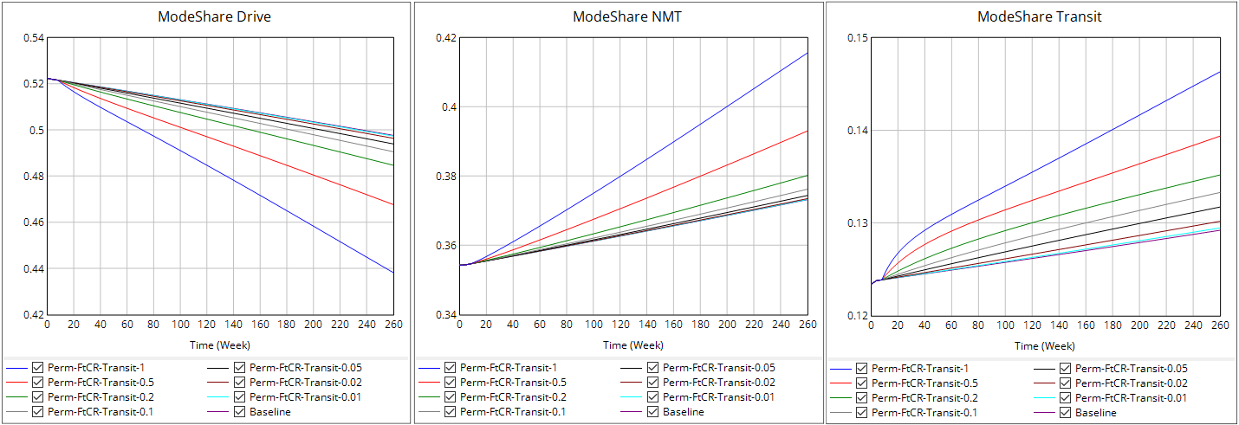
Transit ASU FtCR effect on… Mode Share

Slide 17
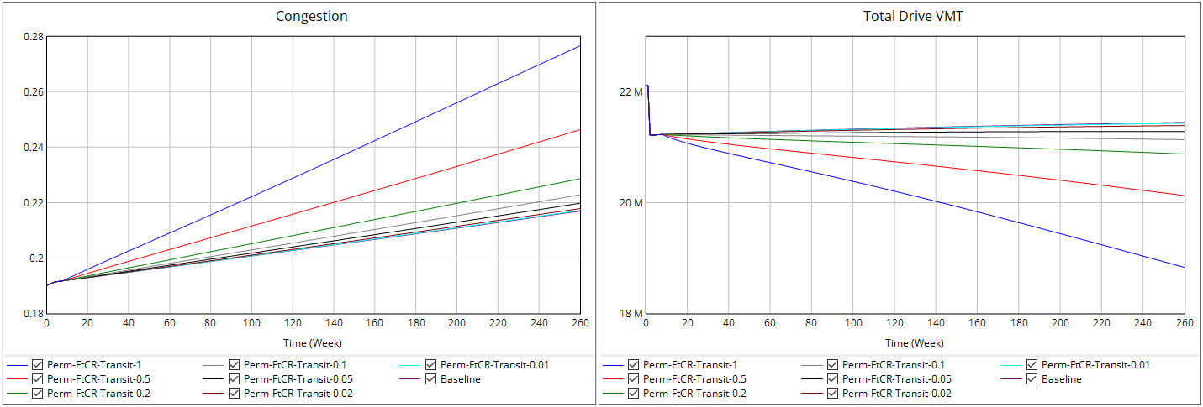
Transit ASU FtCR effect on… Congestion and VMT

Slide 18
Permanent Duration
Changing Destination ASU FtCR
(FtCR values quoted as Comm-SR)

Slide 19
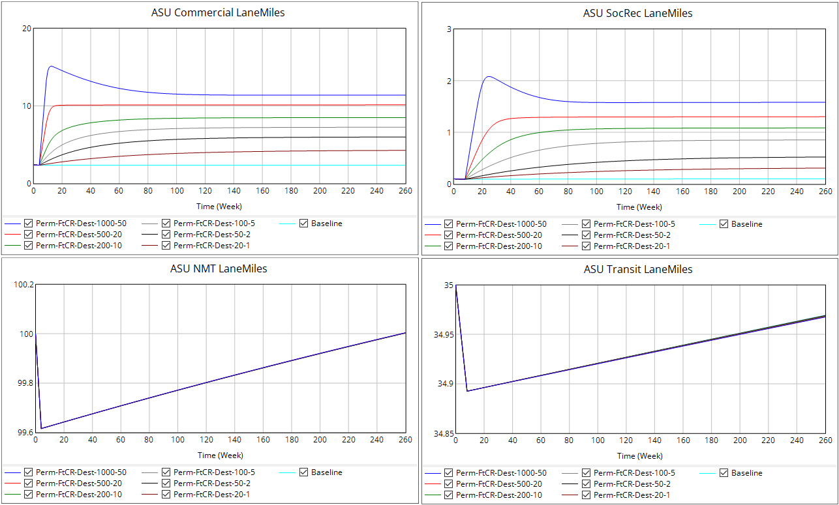
Destination ASU FtCR effect on… ASU Lane-Miles

Slide 20
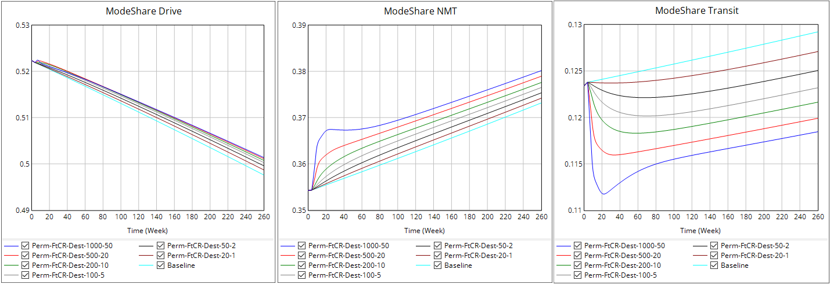
Destination ASU FtCR effect on… Mode Share

Slide 21
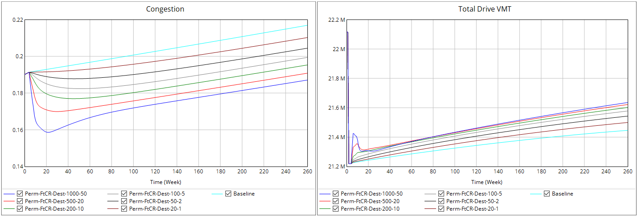
Destination ASU FtCR effect on… Congestion and VMT

Slide 22
Permanent Duration
Changing Mobility ASU FtCR (Monotonic)
(FtCR values quoted as NMT-Transit)

Slide 23
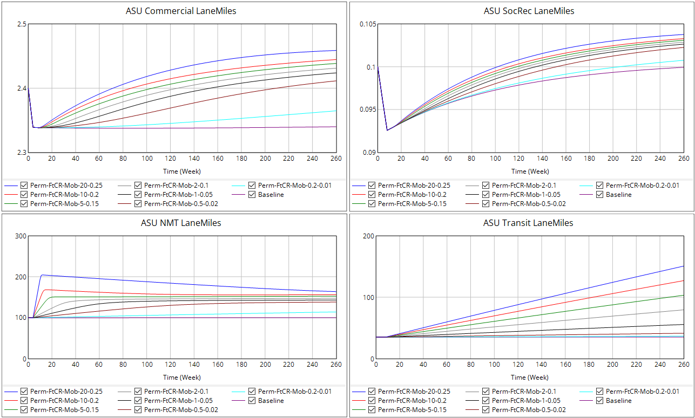
Mobility ASU FtCR effect on… ASU Lane-Miles

Slide 24
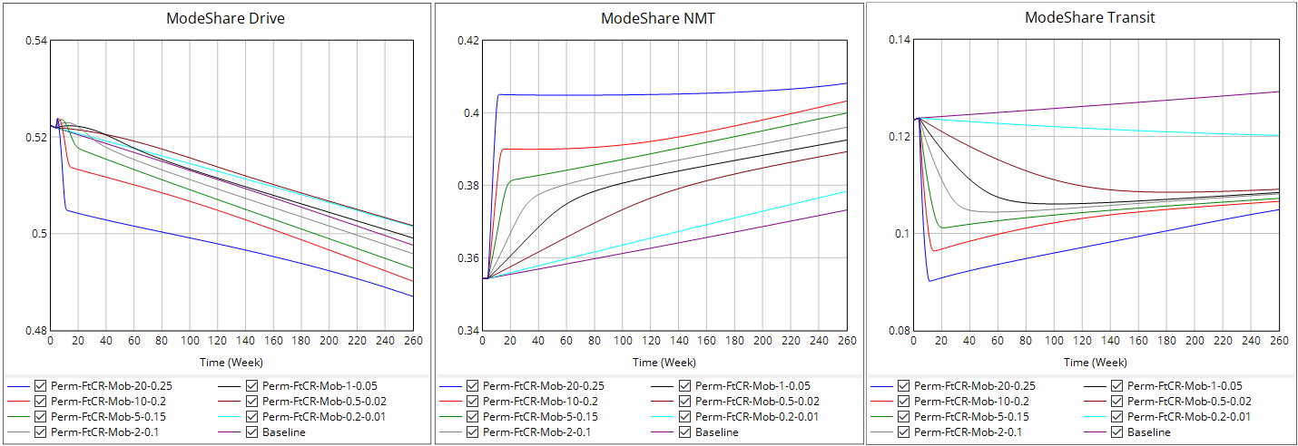
Mobility ASU FtCR effect on… Mode Share

Slide 25
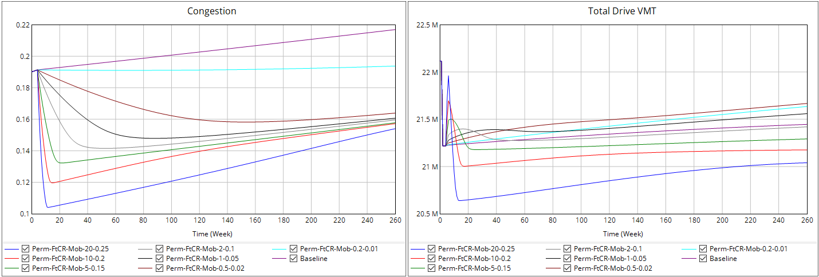
Mobility ASU FtCR effect on… Congestion and VMT

Slide 26
Permanent Duration
Changing Mobility ASU FtCR
(with Transit Threshold)
(FtCR values quoted as NMT-Transit)

Slide 27
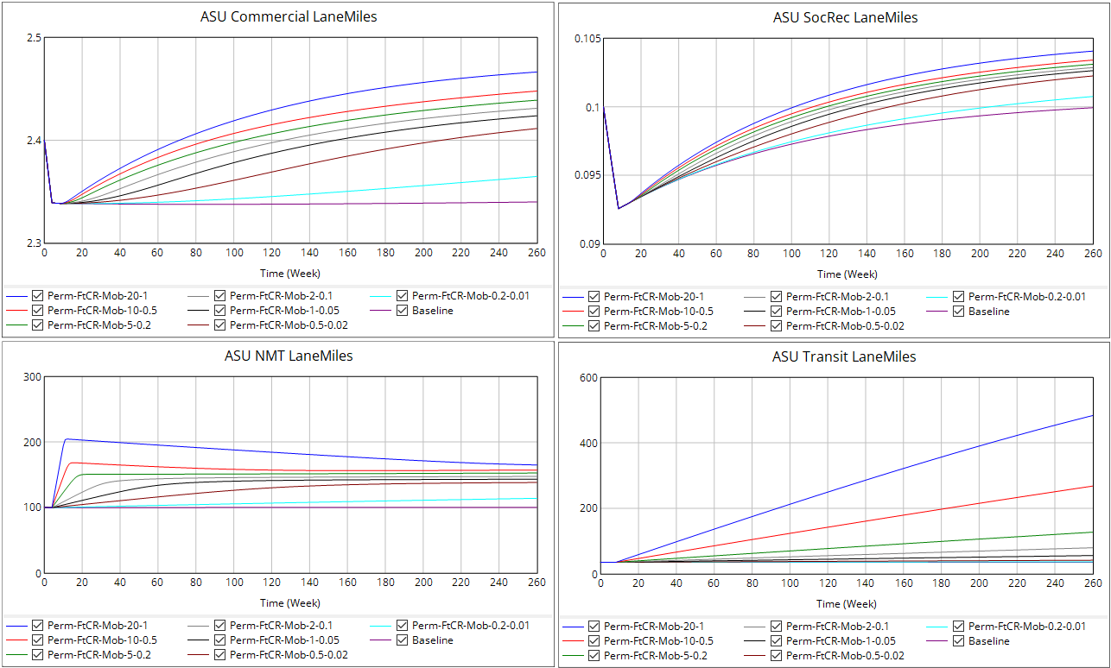
Mobility ASU FtCR effect on… ASU Lane-Miles

Slide 28
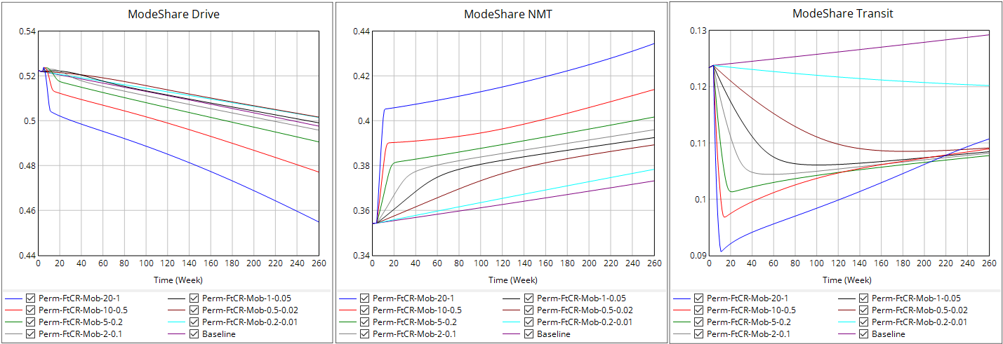
Mobility ASU FtCR effect on… Mode Share

Slide 29
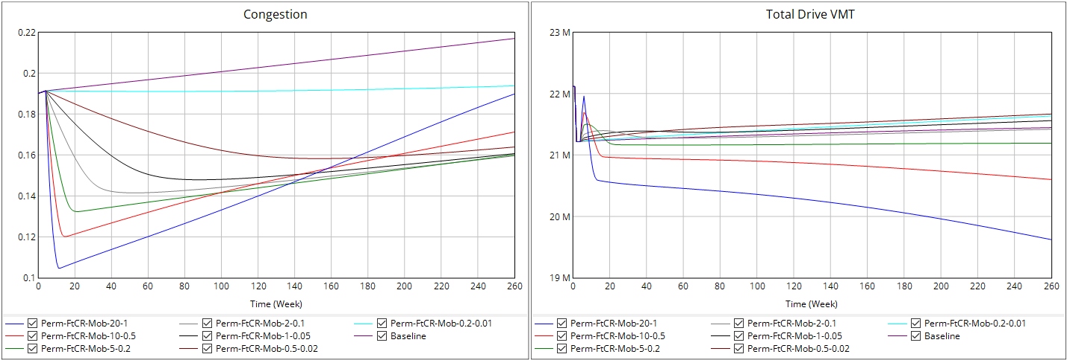
Mobility ASU FtCR effect on… Congestion and VMT

